Slide 1

Disabling Sickness or Condition

Slide 2








Agenda
Financial Planning
Insurance
Military Retirement
Education Planning
Estate Planning
Caring for Aging Parents
Military Consumer Protection
Summary and Resources

Slide 3
Financial Planning

Slide 4







Spending and Saving
Create and manage your spending plan
Four-step process:
    1. Understand your current situation
    2. Know where your money should go
    3. Create a plan
    4. Make adjustments
Notes:
Image source: https://pixabay.com/photos/income-tax-calculator-accounting-4097292/

Slide 5






Financial Considerations
Housing and transportation
    Consider any modifications
    Installation housing
    Long-term care facilities
    Major purchases
Family and Special Needs Planning
Achieving a Better Life Act (ABLE)
Emergency fund
    Start
    Rebuild

Slide 6


Disability Income
VA Disability
    For Soldiers being separated or retired
    Tax-free compensation, based on disability rating
Social Security Disability Income
    Anyone with a disability can apply
    VA compensation will not affect SSDI benefits
Supplemental Security Income
    Needs-based disability benefits
    Based on assets and income
Notes:
Image Source: DVIDS

Slide 7





Taxes
Review your current tax situation
  Make changes as necessary
  Some income may be tax-free
Examine potential tax credits
Keep expense receipts & records
  IRS Publication 502
  IRS Publication 3
Talk to a tax professional
  Military OneSource MilTax
  VITA
  Personal Financial Manager or Counselor
  Installation Legal Office
Notes:
Image Source: DVIDS

Slide 8
Insurance

Slide 9





Health, Dental, Vision, and Property
Health insurance
  TRICARE coverage
  Other medical coverage
    Spouse employer coverage
    Extended Care Health Option
    Federal and state programs
    VA medical clinics and hospitals
Vision
Dental
Property insurance
  Homeowners / renters
  Auto
9
Notes:
Image Source: DVIDS

Slide 10






Exceptional Family
Member Program (EFMP)
Multi-agency program for military
families with a special needs member
  Community Services
  Housing Services
  Medical Services
  Educational Services
  Personnel Services
Respite Care Program
    Mandated by Army Regulation (AR) 608-75
Keep EFMP enrollment current
Notes:
Image Source: DVIDS

Slide 11

Life Insurance
Servicemembers’ Group
Life Insurance (SGLI)
Family Servicemembers’
Group Life Insurance (FSGLI)
Veterans’ Group
Life Insurance (VGLI)
Private life insurance
  Term and permanent coverage
  War clause and other restrictions
  Beneficiaries
  Premium payments
Notes:
Image Source: DVIDS

Slide 12


Life Insurance Needs
Liabilities (debts and obligations)
Income (amount X number of years needed) | +
Final expenses | +
Education and other goals | +
Liabilities (debts and obligations)
Income (amount X number of years needed) | +
Final expenses | +
Education and other goals | +
 | -
Subtract current coverage and available assets
—
Subtract current coverage and assets
Your Total Need:
=
=
VA Life Insurance Calculator:
https://insurance.va.gov/NeedsCalculator
Notes:
Image Source: https://pixabay.com/photos/us-dollars-american-background-bank-84594/

Slide 13
Military Retirement

Slide 14
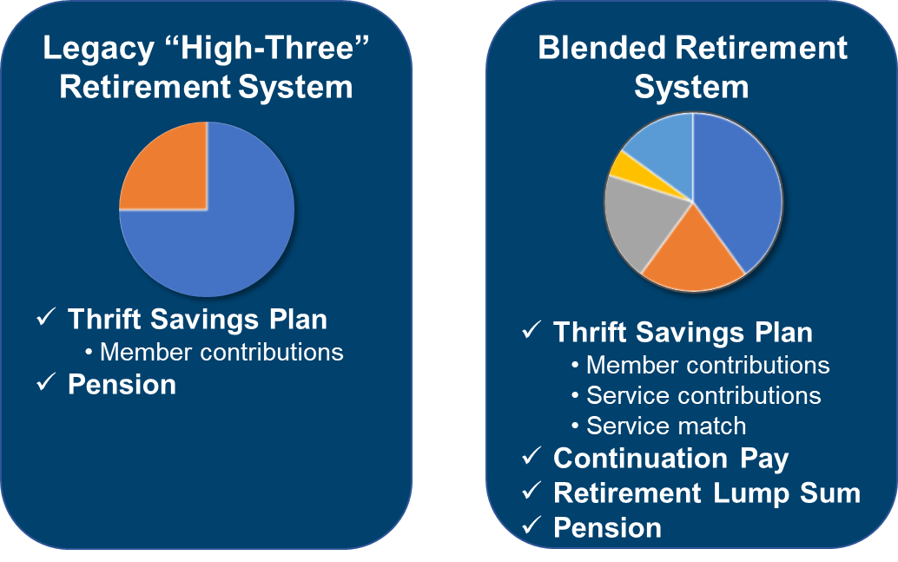
Military Retirement Systems
Which system are you under?
Legacy “High-Three” Retirement System
Blended Retirement System
Thrift Savings Plan
  Member contributions
Pension
Thrift Savings Plan
  Member contributions
  Automatic (1%) contribution
  Service match
Continuation Pay
Retirement Lump Sum
Pension

Slide 15



Retirement Planning
Review: Military Retirement and
Thrift Savings Plan Handouts
Families with special needs may
face additional considerations
EFMP and Retirement
  Systems Navigators
15
15
Notes:
Image Source: DVIDS

Slide 16
Education Planning

Slide 17






Education Planning
Career and Retraining Programs
Military Education Benefits
  Apprenticeship & credentialing
  Tuition assistance
  GI Bills
  Saving for college
Student Loan Repayment
Education Directory for Children with Special Needs
Military Spouse Employment - myCAA
Notes:
Image Source: https://pixabay.com/photos/books-stack-literature-knowledge-5937823/

Slide 18
Estate Planning

Slide 19




Estate Planning
Legal documents
  Special Needs Considerations
  Trusts and Wills
  Family Care Plan
Survivor benefits
  Death Gratuity
  Survivor Benefit Plan (SBP)
  Dependency and Indemnity Compensation (DIC)
  Dependents’ Educational Assistance (DEA)
  Heroes Earning Assistance and Relief Tax (HEART)
  Social Security Survivors’ Benefits
  SGLI
Review and update all documents
Notes:
Image Source: DVIDS

Slide 20
Caring for Aging Parents

Slide 21




Caring for Aging Parents
Housing and care options
  In-home care
  Assisted living / nursing homes
  Residing with family
Making them a dependent
  Many forms, long process
  Consult legal service office
Power of Attorney
Medical insurance
  Consider TRICARE Plus (if a dependent)
  Consider Medicare (if eligible)
21
21
Notes:
Image Source: DVIDS

Slide 22
Military Consumer Protection

Slide 23
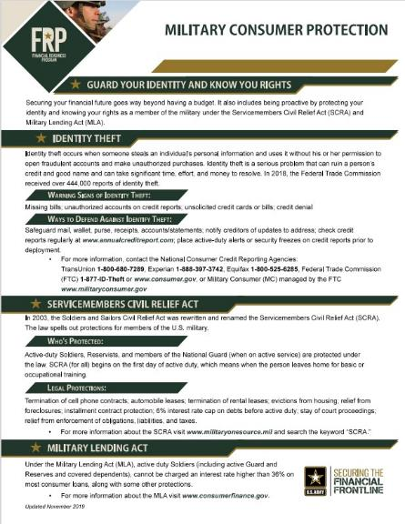
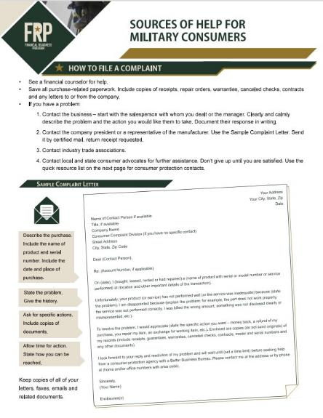
Military Consumer Protection

Slide 24
Summary and Resources
24

Slide 25







Summary
It’s important to have a plan in place to handle any
circumstance that may come your way. It’s also important
to include family members in financial decisions.
Let’s recap the topics we talked about today:
Financial Planning
Estate Planning
Insurance
Caring for Aging Parents
Military Retirement
Military Consumer Protection
Education Planning
Summary and Resources

Slide 26



Resources and Conclusion

Slide 27

Thank You!

